Slide 1
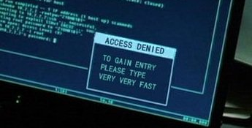
Computer Principles for Programmers
Keyboard Shortcuts in Windows and Visual Studio
Real programmers don’t use a mouse. Neither do actors in movies.
Type like an actor
Notes:
Visual Studio IntelliSense YouTube video at https://youtu.be/bWYNjdLdbZs
Details may not appear when screen sharing during online lecture.
https://hackertyper.net/
Real programmers and movie/TV actors don't use the mouse. Ever seen an actor do anything at a computer other than flail away at a keyboard? https://tvtropes.org/pmwiki/pmwiki.php/Main/RapidFireTyping
http://geektyper.com/unsc/ [use Backspace key to select other styles]
https://geekprank.com/hacker/
http://thepierealm.coffeecup.com/hackerTyper/
https://userinterfaces.aalto.fi/how-we-type/ i.e. type any way you want
https://io9.gizmodo.com/the-10-goofiest-computer-hacking-scenes-in-cinema-histo-5643388
See also https://www.nngroup.com/articles/movies-usability-top-10-bloopers/
Google: using computers in movies –and– actors typing keyboards in movies
things that you learn about computers, as shown in the movies... From http://www.mwc.co.uk/humour.htm
1. Word processors never display a cursor. 2. You never have to use the spacebar when typing long sentences. 3. All monitors display 2 inch high letters. 4. High-tech computers, such as those used by NASA, the CIA, or some such governmental institution, have easy-to-understand graphical interfaces. 5. Those that don't will have incredibly powerful text-based command shells that can correctly understand and execute commands typed in plain English. 6. Corollary: You can gain access to any information you want by simply typing "ACCESS ALL OF THE SECRET FILES" on any keyboard. 7. Likewise, you can infect a computer with a destructive virus by simply typing "UPLOAD VIRUS." Viruses cause temperatures in computers, just like they do in humans. After a while, smoke billows out of disk drives and monitors. 8. All computers are connected. You can access the information on the villain's desktop computer, even if it's turned off. 9. Powerful computers beep whenever you press a key or whenever the screen changes. Some computers also slow down the output on the screen so that it doesn't go faster than you can read. The *really* advanced ones also emulate the sound of a dot-matrix printer as the characters come across the screen. 10. All computer panels have thousands of volts and flash pots just underneath the surface. Malfunctions are indicated by a bright flash, a puff of smoke, a shower of sparks, and an explosion that forces you backward. (See #7, above) 11. People typing away on a computer will turn it off without saving the data. 12. A hacker can get into the most sensitive computer in the world before intermission and guess the secret password in two tries. 13. Any PERMISSION DENIED has an OVERRIDE function. 14. Complex calculations and loading of huge amounts of data will be accomplished in under three seconds. In the movies, modems transmit data at two gigabytes per second. 15. When the power plant/missile site/whatever overheats, all the control panels will explode, as will the entire building. 16. If you display a file on the screen and someone deletes the file, it also disappears from the screen. There are no ways to copy a backup file-and there are no undelete utilities. 17. If a disk has got encrypted files, you are automatically asked for a password when you try to access it. 18. No matter what kind of computer disk it is, it'll be readable by any system you put it into. All application software is usable by all computer platforms. 19. The more high-tech the equipment, the more buttons it has. However, everyone must have been highly trained, because the buttons aren't labelled. 20. Most computers, no matter how small, have reality-defying three-dimensional, real-time, photo-realistic animated graphics capability. 21. Laptops, for some strange reason, always seem to have amazing real-time video phone capabilities and the performance of a CRAY-MP 22. Whenever a character looks at a VDU, the image is so bright that it projects itself onto his/her face. 23. Computers never crash during key, high-intensity activities. Humans operating computers never make mistakes under stress. 24. Programs are fiendishly perfect and never have bugs that slow down users. 25. Any photograph can have minute details pulled out of it. You can zoom into any picture as far as you want to. For example: "What's that fuzzy thing in the corner? I don't know, let's check. It's the murder weapon!". "Let's look under the bed for the killers shoes. No, just some comics books (Marvel 1954, very rare). Let's check the closet shelves..." 26. All the financial and accounting information of any multi-billion-dollar international company can fit on a single 3 1/2" floppy.

Slide 2
Share ideas for understanding the problem, not the answers or code.
Talk all you want, don’t copy or share files.
Avoid the use of paraphrasing tools. "Evade the utilization of rephrasing implements.“
Paraphrasing is plagiarism unless the source text is clearly cited and referenced.
Notes:
Understanding the problem is “Well begun, half done.” Grok the issues and the solution may present itself.
Simple paraphrasing is plagiarism unless the source text is clearly cited and referenced. Rewording someone else’s work with equivalent semantics is obfuscation, not scholarship.
https://owl.english.purdue.edu/owl/resource/619/1/
This is not only an academic issue. It is even more important as a professional. You wouldn’t appreciate someone stealing your work (violating your copyright) and making money off your efforts.
Stealing other people’s research or using Open Source code contrary to the license will get you fired, sacked, terminated with cause. The startup you were fired from was likely financed by the mortgage on the boss’s house — she’ll lose it settling the lawsuits you caused.
"I didn't know" is not a credible excuse for cheating or plagiarism.
Assignment and quiz 'answers' from other students can be found through a web search. Using academic work found on 'study' websites is a violation of academic integrity. So is posting it there. SafeAssign can easily find and identify those items when they are submitted again. The 'answers' are usually wrong, and glaringly so. ("A" students tend not to post their work for use by others.)
Only journals, library resources, published books, and reputable websites count as research for ideas learned or quotations taken to support your work. However, using such legitimate research without citation and referencing, is still plagiarism.
Paraphrasing does not count as original work – it barely qualifies as a grammar exercise. Paraphrasing is plagiarism if the source and the scope of paraphrasing is not cited and referenced.

Slide 3
You are not here to get marks. You are here to learn something.
Do not copy and paste anything without citation and references.
Notes:
You are not here to get marks. You are here to learn something. Marks are the result of your work and learning.
If you present someone else’s answers as your own, then there is no work of yours to earn marks.
IPC144, Week 1 Reflection:
“I have learned about Assignment Submission, navigating in a command line environment, using "printf()" statements in C and overcoming some of its syntactic delicacies. Most importantly, I have learned to do it myself, which was not generally my approach towards studies.”
Submissions are checked for plagiarism using SafeAssign. Students can view SafeAssign’s originality report for each activity submission. There is a time delay generating the report. N.B. SafeAssign cannot count or do arithmetic – ignore the percentage match; it sometimes shows a 100% match even when your own unique answers are not matched. You will see it matching on questions, and some of the standard answers. Of course it matches on the question text! Everyone gets the questions! But SafeAssign has no way for the professor to mask out text that everyone gets. (It is really pathetic indicating whoever wrote it never taught a class. Even more likely, never graduated from primary school. (see above math skills) What SafeAssign does do well is highlight cases were answers may have been copied from other student assignments or outside resources. Examine the details of individual matches in the SafeAssign report. If the details show a match with your answers, then we might have a problem.
Beware of doing business with or investing in a company which says they are in business to make money. Delivery of quality products and services is the business. Money is the result of doing business, not the purpose.
Marks are the result of doing the work. It is process before payout.
Explaining why you don’t know the answer is a better alternative than desperately searching, copying, and pasting an answer you may not understand. The latter makes it easy to catch plagiarism.
Cheating or plagiarism is presenting someone else's words or ideas or coding as your own.
This applies to activities, quizzes, assignments, and tests, in whole and in part.
Copying even a small part without attribution is dishonest and affects the entire work submitted as your own.

Slide 4
Keyboard Shortcuts Agenda
Mice are good for users and cats.
All you should need on a web form is TAB & ENTER.
Essential keyboard shortcuts on Windows.
Keyboard shortcuts within Visual Studio IDE.
Details of Using File Explorer are found at end of this "deck". …as in slide deck…as in business lingo.
Notes:
Why keyboard shortcuts? Because you create documents and source code by typing. At a keyboard. Why leave the keyboard to find a mouse, find the cursor and so on, when you could do the same things with keyboard shortcuts?
Web forms: you may need the mouse for initial positioning if the programmer has not done that for you. Good web forms do not require the user to employ a mouse.
Week 1 package has a Visual Studio self-guided introduction if you missed it last week.

Slide 5
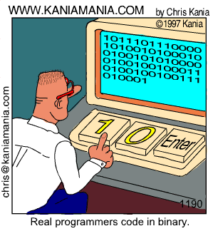
First Computer Keyboard
Notice:
No Mouse.
Notes:
http://9gag.com/gag/133978/

Slide 6

Windows System Shortcuts
Notes:
The magic Windows key… Look! Microsoft has a special key only for Windows PCs. So, please don't buy an Apple computer. Apple keyboards have a "Command" key. (As have IBM mid-range servers since the 1970s.) This means please don't buy a Windows type computer.

Slide 7

Snapping Windows - Side by Side
+ ← → snap half screen
  to select app on other ½
Hold + ←↑↓→ snaps to quadrants or other screens
+ ↑ maximize window
+ ↓ restore from max or minimize window
Notes:
Use the Windows Key and an arrow key to move and arrange windows on the screen(s)

Slide 8
Windows System Shortcuts
Windows key: start typing to find anything + Tab: display all active applications Alt + Tab: switch to previously active application Ctrl +Tab: switch between tabs within application Alt+F4:Alt+spBar,C: Close app. Ctrl+{F4|W}: Close tab.
+ L: Lock PC or switch account. (n/a in Seneca Labs)
+ E: Open File Explorer.
+ R: Open Run dialog box to start an application
+ D: Show/hide Desktop.
Notes:
Alt + spacebar, C is easy to input from the home row and closes a program like Alt + F4
Windows key symbol in "HoloLens MDL 2 Assets" font. This contains, no only the Windows key, but other useful system symbols.

Slide 9
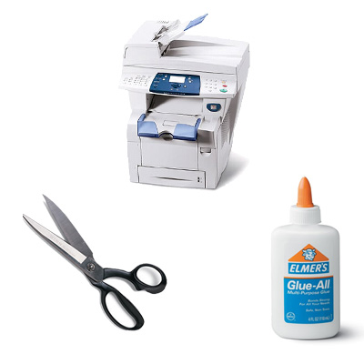
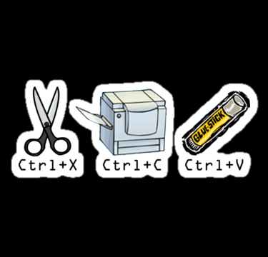
Essential Keyboard Shortcuts in Windows
Notes:
in kindergarten class, you learned to cut and paste and trace (copy). The keyboard metaphors are not an accident.
Windows took Ctrl+X,C,V from the Lisa and Mac projects at Apple who took it from Xerox PARC (Palo Alto Research Center) founded in 1970 with the charter to create “The Office of the Future”
There are other shortcut keys which we will get to in the activity section.
http://www.digitaltrends.com/computing/cut-copy-paste-beginners-guide/
http://www.howtogeek.com/115664/42-text-editing-keyboard-shortcuts-that-work-almost-everywhere/
https://support.microsoft.com/en-ca/help/12445/windows-keyboard-shortcuts
http://www.hongkiat.com/blog/100-keyboard-shortcuts-windows/

Slide 10

Windows Editing Shortcuts
Do you use a mouse to cut, copy, paste? No – too slow. Ctrl + Z / X / C / V / Y – undo, cut, copy, paste, redo
Undo is handy for unwanted AutoCorrections
+ V to paste from clipboard history. Pin to keep!
Ctrl + F is for find
Ctrl + H to find and replace text (be careful)
Ctrl + S saves the file (save early, save often)
consider Autosave and the pros and cons to using it.
Notes:
"Important: If you're not using AutoSave or if your file is not stored on OneDrive or SharePoint, the Save button is still your best friend. To be sure you don’t lose your latest work, select Save (or press Ctrl+S) often."
https://support.office.com/en-us/article/help-protect-your-files-in-case-of-a-crash-551c29b1-6a4b-4415-a3ff-a80415b92f99

Slide 11
Navigation Shortcuts in Windows
Home: go to start of line. CTRL+Home: top of document
End: go to end of line. CTRL+End: bottom of document
SHIFT+Home/End selects from cursor position to start/end
Alt+Shift+Up/Down: Moves the paragraph up/down. Or, select any portion of multiple paragraphs and move all.

Slide 12
Navigation Shortcuts in Windows
CTRL + Right → go forward one word
CTRL + Left ← go backward one word
CTRL + Up ↑ go to previous paragraph
CTRL + Down ↓ go to next paragraph
CTRL + A selects ALL
SHIFT + ←↑↓→ selects char, + Ctrl selects word
Notes:
CTRL + Up / Down will scroll window pane contents up / down one row/line at a time. It is similar to page down which moves a pane's worth of lines up / down.

Slide 13
Visual Studio IDE
To develop an application, edit your source code, save the source file in an organized place, compile/build the program, and run/debug your program.
An industrial strength IDE like VS does all these steps in an integrated development environment, instead of doing each step with different software/shell and switching among those.
… letting you concentrate on your development job.
Notes:
IDE = Integrated Development Environment

Slide 14
Visual Studio IDE
Developers work inside IDEs like VS most of the time.
Keyboard shortcuts save time and facilitate your job there.
Keyboard shortcuts are vital to productivity.
Other development advantages with an IDE like VS: create games, web, mobile, and cloud based apps, connect to databases, team services and collaboration, version control, package and release management, repositories, Git support, and more.

Slide 15
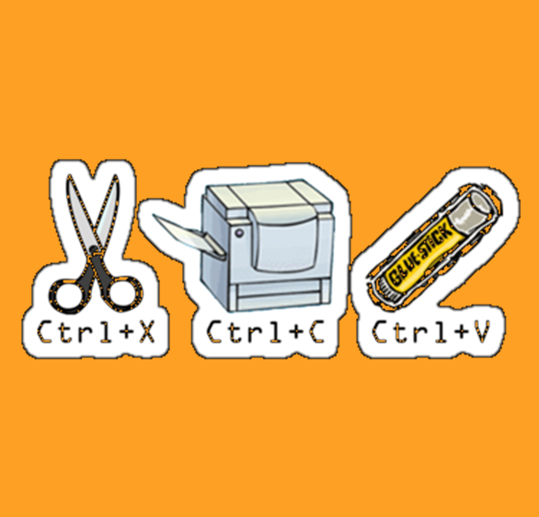
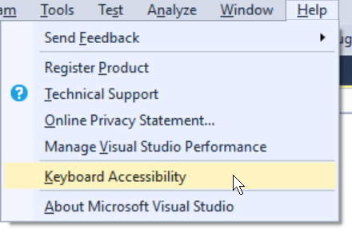
Useful Keyboard Shortcuts in VS IDE
Windows selection & editing shortcuts work in Visual Studio
Notes:
VS IDE, Help menu / Keyboard Accessibility ( ALT+H K )
https://docs.microsoft.com/en-ca/visualstudio/ide/reference/how-to-use-the-keyboard-exclusively

Slide 16
Special Keyboard Shortcuts in VS IDE
Ctrl + KD formats source code
F7 or Ctrl + Shift + B builds your application
Ctrl + F5 runs it
Alt + Up ↑ moves current / selected lines up Alt + Down ↓ moves current / selected lines down
Ctrl+KC Comments current / selected lines Ctrl+KU Uncomments current / selected lines

Slide 17
Special Keyboard Shortcuts in VS IDE
Rename
Ctrl+RR with cursor on a variable name
Copy, Cut, Duplicate a line the cursor is on (without any selection of a line or text)
Ctrl+C – Copy line
Ctrl+X – Cut line
Ctrl+D – Duplicate line
Notes:
DO NOT FIND and REPLACE – dangerous. Always rename a variable.

Slide 18
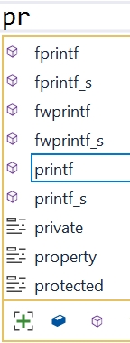

Visual Studio IntelliSense
Code and variable name completion
Start typing + TAB to complete
type ( and its completing pair ) is inserted; same with " Ctrl + Spacebar turns on IntelliSense
before you start typing or, when it is staying out of your way, to turn it back on.
See demo on next slide
Notes:
* IntelliSense assists programming by offering automatic code and syntax completion.
* IntelliSense is sensitive to the source file extension, e.g. _____.c for C language source files. Only items relevant to that source file language are displayed.
* IntelliSense is activated when you begin to type a command, function, or variable name, e.g. "pr" to print. A list appears with items matching the characters typed.
* Pressing TAB selects the default item and completes your partially typed code. Use Up/Down to select a different item in the IntelliSense list and press TAB or Enter to insert that item.
* Ctrl + Spacebar turns on IntelliSense before you start typing or when it is staying out of your way
* Key ( for a left parenthesis, and the right hand ) is automatically inserted with the cursor positioned between them; for a function like printf, the comments and parameters are shown.
* Key " to open a quoted string of characters and IntelliSense automatically inserts a matching double-quote "; the cursor is positioned inside the quotes ready for the entry of a text string. This works for any matched pair of punctuation marks: ( ) { } [ ] " " ' ' /* */

Slide 19
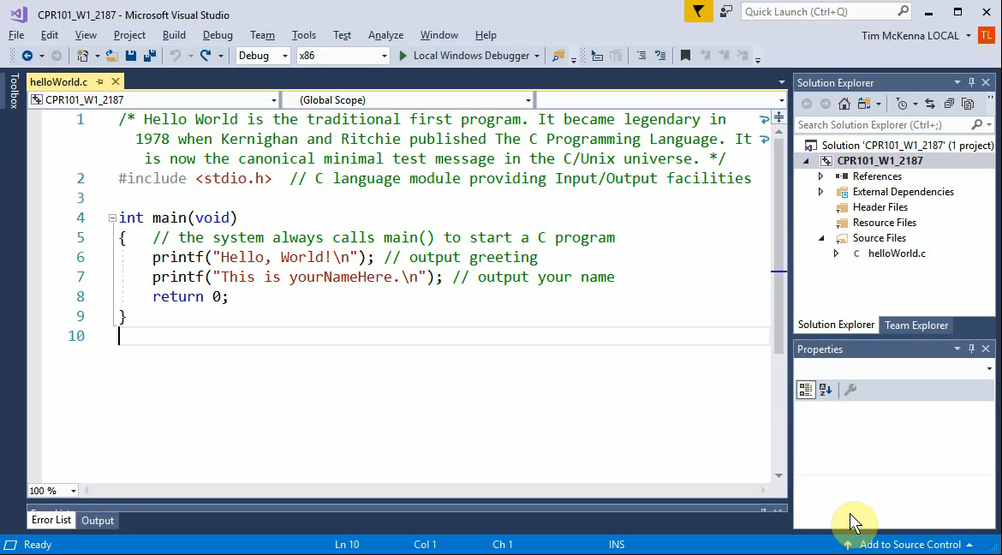
For animation, hover mouse cursor over image and click PLAY  triangle in bottom left
➔
Notes:
Unlisted YouTube video at
https://youtu.be/bWYNjdLdbZs
Details do not appear when screen sharing during online lecture.

